Slide 1
Merchant Center Account

Slide 2
Agenda
What is merchant account
Why it is Important
Merchant Center Account Set Up
Feed Generation from Product Feed Pro Plugin

Slide 3
Why it is Important
The Merchant Center account entails one major benefit: it is a gateway to advertising your products with Google Shopping. It allows you to store essential product information needed to generate and serve your product ads to potential customers.
Without Google Merchant Center (GMC), your products will not appear on Google Shopping. Also, you cannot create Product Ads unless you add sufficient product information to your GMC account.
If you sell products directly to consumers, Google Merchant Center is one of the tools you need. It should be an integral part of your overall digital marketing strategy.

Slide 4
How to set up a Google Merchant Center account
Sign up for a Google account if you don’t already have one.
Create a merchant Center account.
Add your business information.
Verify your business URL.
Set up shipping.
Set up sales tax.
Add products.
Review Google's product policies.
Submit for review.

Slide 5
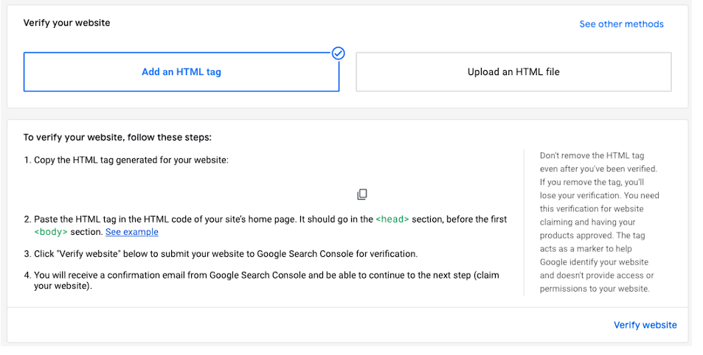
How to set up a Google Merchant Center account
Add your business information.
The business details you'll be requested to enter will depend on the type of business you're setting up. Follow Google’s prompts to ensure you provide all required information, which may include the business name and address, website, and contact details. You may be asked to provide a phone number for verification.
Verify your business website
To link your website to the merchant account, Google will ask you to verify ownership and claim your website URL my adding an HTML tag or uploading an HTML file to your site. You may also choose to verify through Google Analytics if you're already using it on your site.

Slide 6
How to set up a Google Merchant Center account
Add your business information.
The business details you'll be requested to enter will depend on the type of business you're setting up. Follow Google’s prompts to ensure you provide all required information, which may include the business name and address, website, and contact details. You may be asked to provide a phone number for verification.
Verify your business website
To link your website to the merchant account, Google will ask you to verify ownership and claim your website URL my adding an HTML tag or uploading an HTML file to your site. You may also choose to verify through Google Analytics if you're already using it on your site.

Slide 7
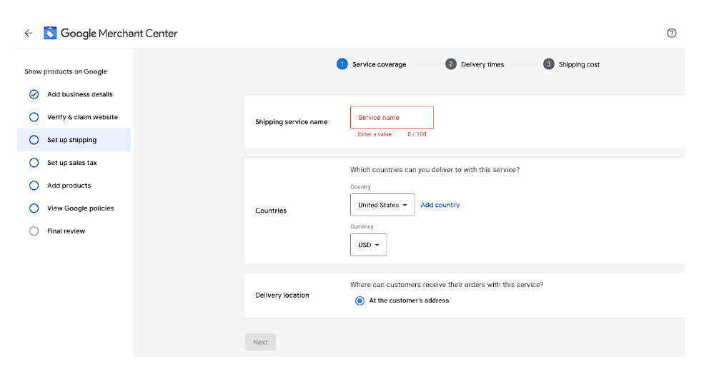
How to set up a Google Merchant Center account
Set up shipping.
On this screen, you can select which countries you deliver to, and choose a currency and delivery location.

Slide 8
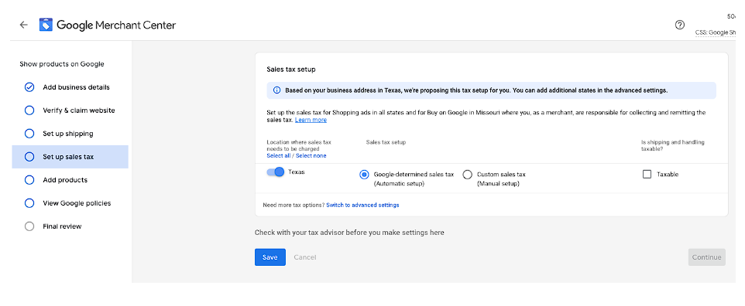
How to set up a Google Merchant Center account
Set up sales tax.
Google will suggest a tax setup for you based on the location of your business. You can choose to let Google determine the amount of sales tax to collect or opt to set this up manually. You can also select whether shipping and handling charges are taxable or not.
Add products.

Slide 9
Word Press Plugin- Google Product Pro
What is a Product Feed?
A product feed is simply a file that is made up of a list of products and attributes of those products. All of the products in a shopping feed are organized so that each can be displayed, advertised, or compared in a unique way.
There are several items that are displayed in most (if not all) product feeds. They include things like the product image, the title of the product, identifiers, marketing copy, and product attributes.
Today, I am going to show you how to use a smooth plugin in conjunction with WooCommerce that allows you to quickly and easily build multiple product feeds.
Let’s take a look at the plugin in question and see all it has to offer.

Slide 10
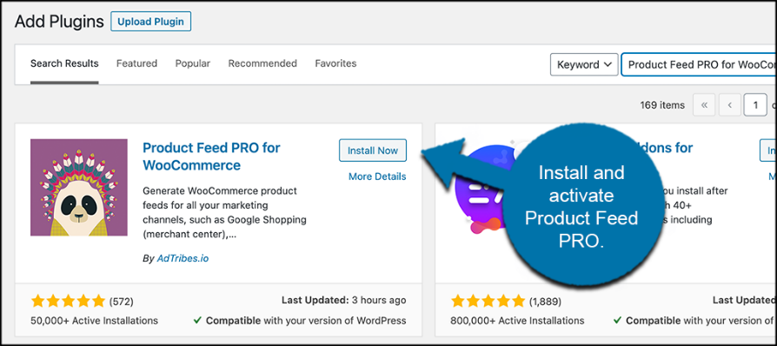
Word Press Plugin- Google Product Pro
Step 1: Install and Activate the Plugin
Before you can start using Product Feed PRO for WooCommerce, you first need to install and activate the plugin. You can easily do this by jumping over to the Plugins page in the WordPress admin dashboard.
Simply use the available search field to search for the plugin by name.
When you see it pop up, install and activate it right from there.

Slide 11
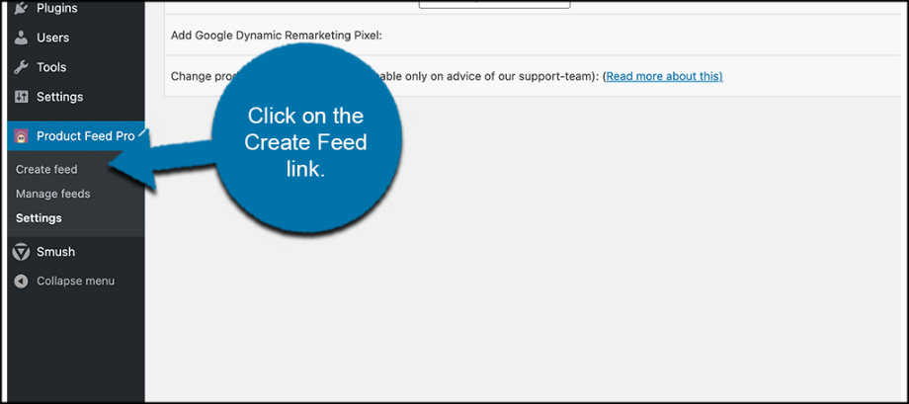
Step 2: Create a Product Feed
Plugin settings are in-place according to how you want. Now, you can go create your first product feed.
Click on the “Create Feed” link located under the main Product Feed PRO menu item.
Go ahead and fill in all of the general feed settings. This includes creating a name for your project (feed), deciding on a country and a channel from the dropdown, and choosing a file format and refresh interval time.

Slide 12
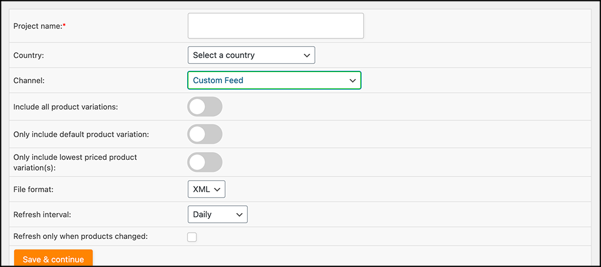
Word Press Plugin- Google Product Pro
Go ahead and fill in all of the general feed settings. This includes creating a name for your project (feed), deciding on a country and a channel from the dropdown, and choosing a file format and refresh interval time.

Slide 13
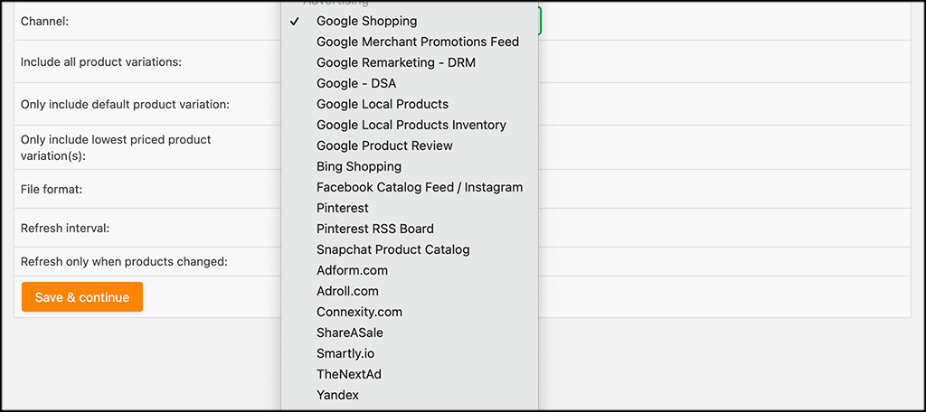
Here are just some of the different feeds you can choose from.
Once you are ready, click on the “Save and Continue” button.

Slide 14
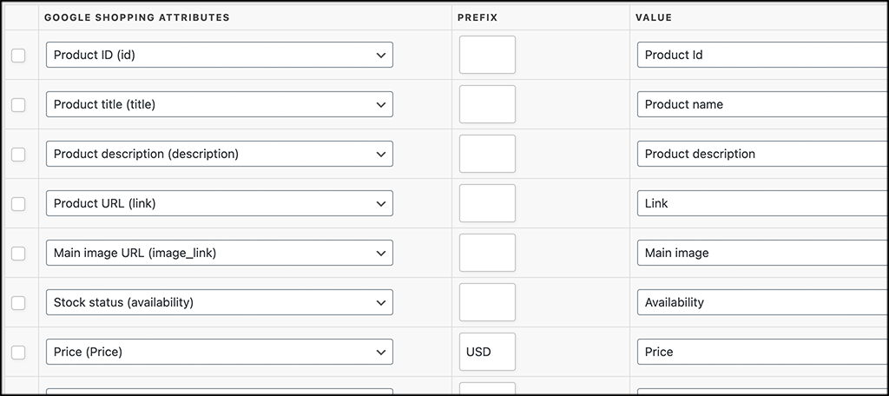
Step 2: Add Field Mapping
This page is full of all the field mapping fields available in Google Shopping. Go ahead and fill them all out however you want your products displayed in the product feed.
At the bottom of the page, you will notice the buttons for adding field mapping, adding custom fields, or “Save.” Finish up what you need to do and click on the “Save” button.

Slide 15
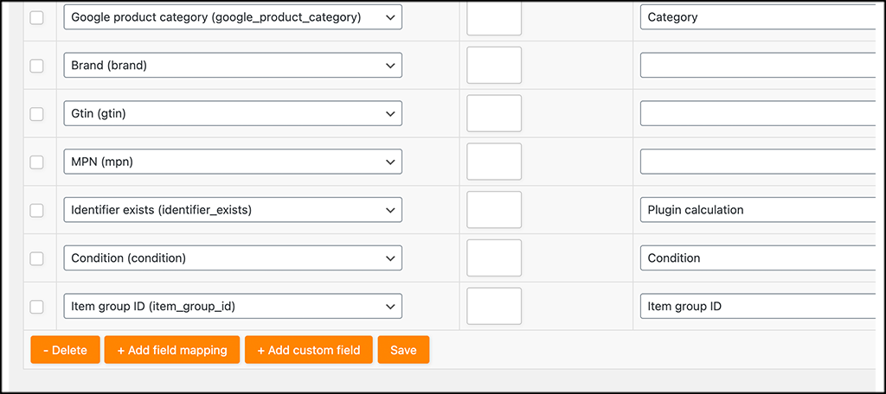
Word Press Plugin- Google Product Pro
At the bottom of the page, you will notice the buttons for adding field mapping, adding custom fields, or “Save.” Finish up what you need to do and click on the “Save” button.

Slide 16
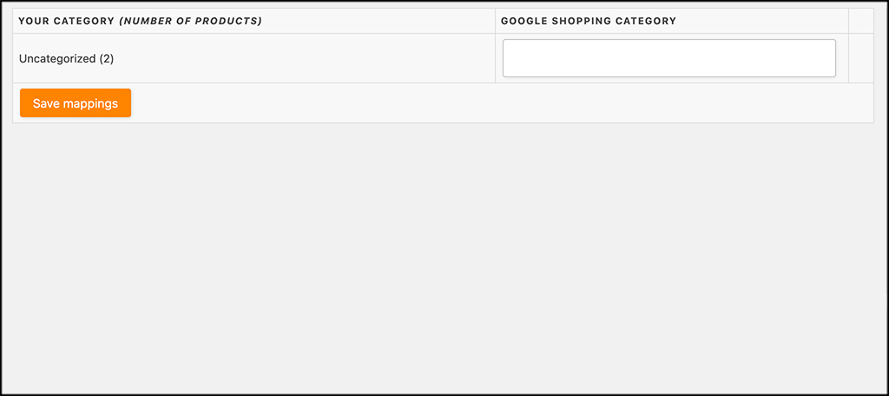
Word Press Plugin- Google Product Feed Pro
Step 4: Add Category Mapping
This takes you to the “Category Mapping” page. This will show items based on what you filled out above. Choose a Google Shopping Category and click on the “Save Mappings” button.

Slide 17
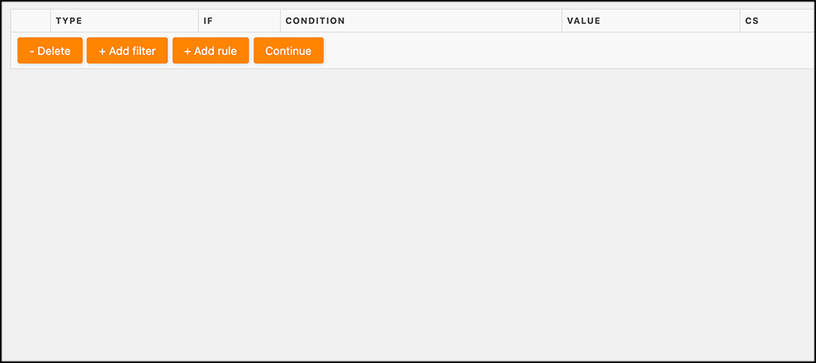
Word Press Plugin- Google Product Feed Pro
Step 5: Customize Feed Filters and Rules
Now, create your feed filters and rules. You can add a rule, add a filter, delete, and then continue when you are finished.

Slide 18
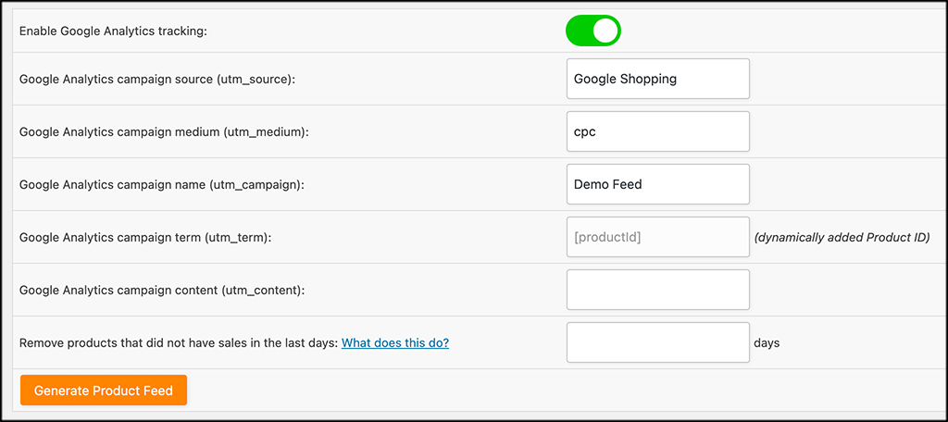
Word Press Plugin- Google Product Feed Pro
Step 6 Apply Any Conversion and Google Analytics Settings
Last but not least, apply any Google Analytics settings and conversion settings you want on this page.

Slide 19
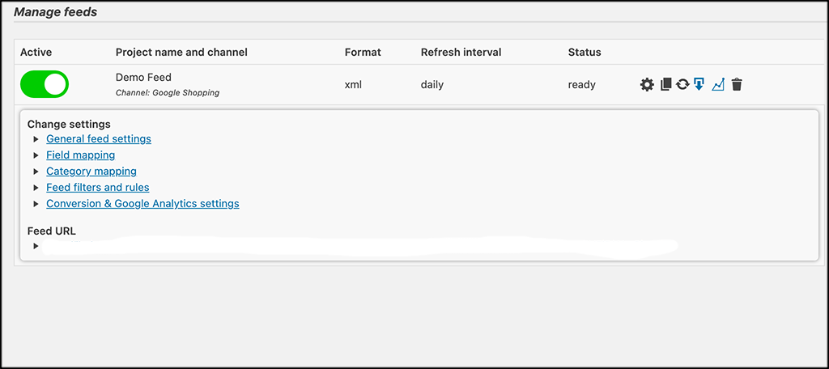
Word Press Plugin- Google Product Feed Pro
Click on the “Generate Product Feed” button when finishing your options.
That’s it! You have built your first product feed using the Product Feed PRO for WooCommerce plugin.

